Slide 1
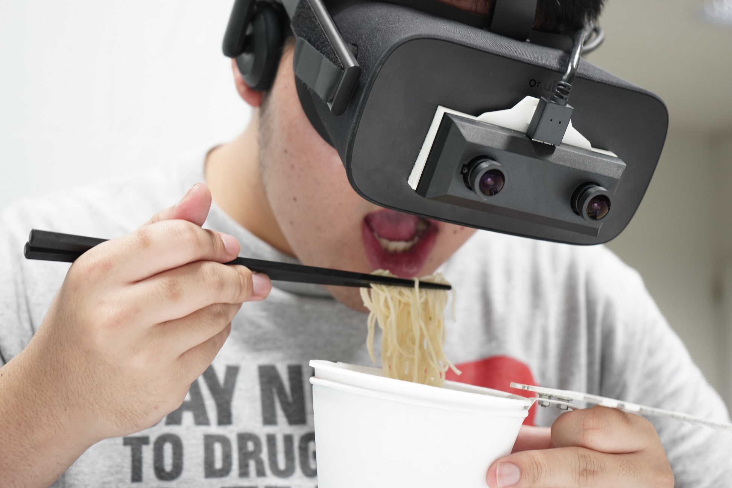

Slide 2
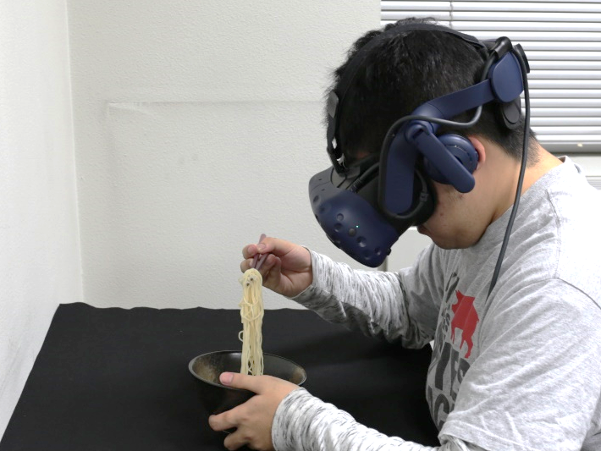
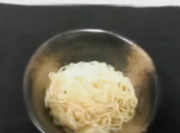
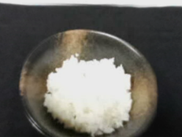
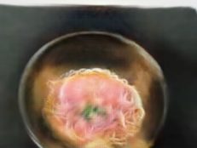
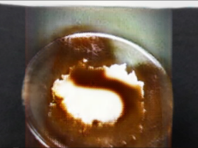
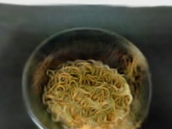
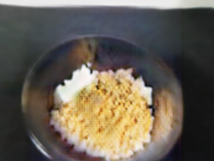
INPUT
Somen noodles
Somen noodles
HTC VIVE Pro
HTC VIVE Pro
Actual food in a bowl
Steamed rice
Actual food in a bowl
Steamed rice
OUTPUT
Ramen noodles
Curry and rice
Fried noodles
Fried rice
Ramen noodles
Curry and rice
Fried noodles
Fried rice

Slide 3


